Slide 2
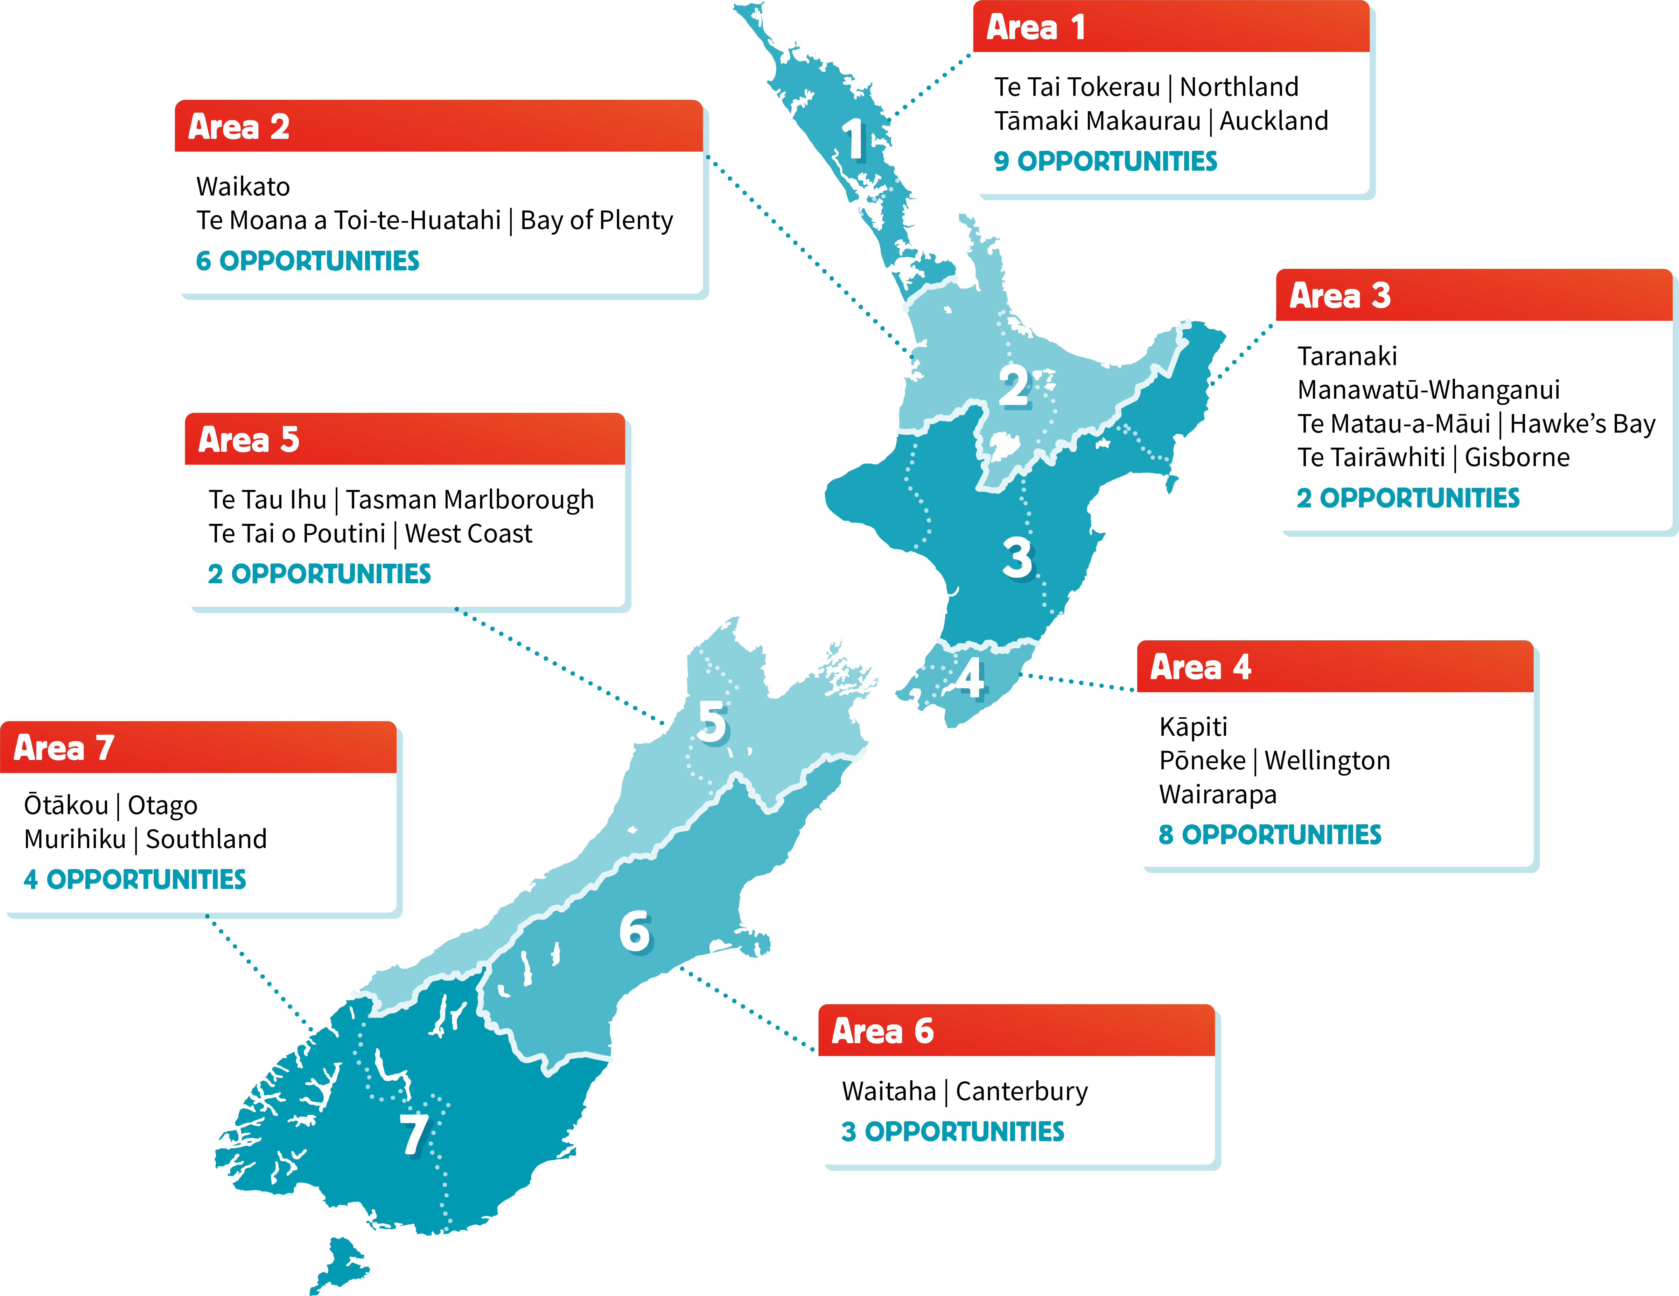
Available
Opportunities

Slide 3
WHO ARE WE LOOKING FOR?
All Red Cross members are eligible to join Councils, and to vote - whether you are part of meals on wheels, retail or migration services or our community programmes.
We’re looking for positive people with the confidence to take initiative who can help us
make the most difference locally,
grow our youth members to 30% of our total membership,
strengthen relationships with Māori and local communities,
become more impactful, diverse and engaging,
achieve our Strategy 2030 goals.

Slide 4
WHO ARE WE LOOKING FOR?
We need people with a range of backgrounds, skills and experience, from leadership or governance, to lived experience of humanitarian work.
We also strongly encourage young people (those under 30) with an interest in leadership to get involved. This year, every Area Council must have at least one youth member. You don’t need to have governance experience and your governance development will be supported.

Slide 5
WHY STAND?
The role is a chance to lead, and to grow.
It is a chance to give back and may even set you on a development path that includes work for the Movement on the global stage, as it did for our National President and National Youth Representative.
Our area councils lead, coordinate and nurture our organisation, our people and our humanitarian activities across areas of Aotearoa New Zealand.
This role requires a commitment of around 6-8 hours a month and occasional travel. The term of office is three years.
You must be able to attend monthly Area Council meetings (which are often on-line) and be active in supporting activities in your Area.

Slide 6
HOW THE PROCESS WORKS
Opportunities to join our Area Councils take place through an annual, two-step process.
Step 1 is nominations. Step 2 is elections.

Slide 7
STEP 1
To be elected, a New Zealand Red Cross member must first be nominated by two current members.
To do this you need to:
Find two current members to support your nomination.
Complete an Area Council Nomination form (the form is on our website).
Send the completed nomination form to membership@redcross.org.nz by Sunday 31 March 2024.
The Membership team will send your form to the Area Council Chair, who will ensure the nomination form is correct.
The form is then sent to the Secretary General to proceed to Step 2.

Slide 8
STEP 2
After Sunday 31 March we will assess whether an election is needed in any of our Areas. Nominees and their Area Councils will be notified of the results, whether an election is needed and what happens next.
Where there are more nominations received than there are vacancies, an election process will take place, with voting in May.
If the number of nominations received either matches, or is less than, the number of vacancies in an area, those nominees are confirmed as elected unopposed.
If we do need elections, voting papers will be sent out in the post, so we need up-to-date membership details, including postal addresses.
You can update your own details online through an easy form in just two minutes, or by calling the Contact Centre on 0800 RED CROSS (0800 733 27677).

Slide 9
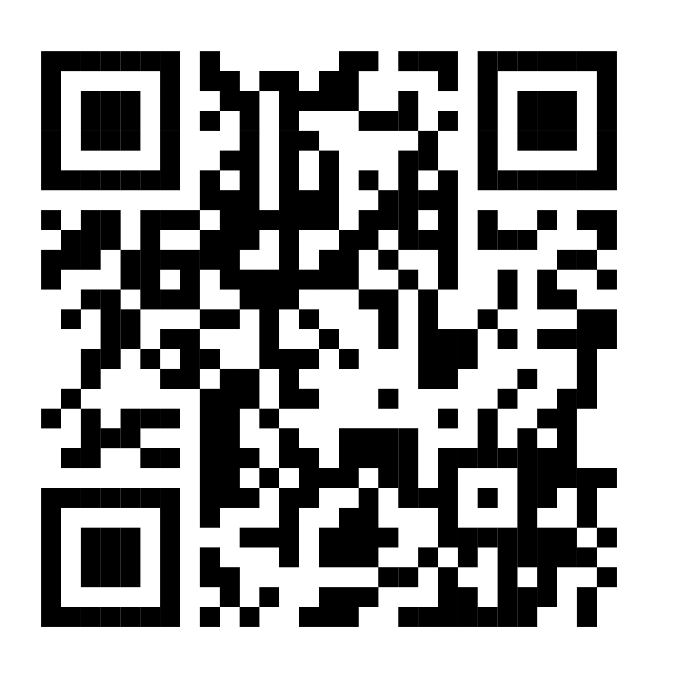
FIND OUT MORE
Find out more about the process on tinyurl.com/nzrc-ac-noms
Or contact your local Area Support Team via membership@redcross.org.nz or by calling 0800 RED CROSS (0800 733 27677).

